Slide 1

CREDIT CARD FRAUD DETECTION USING MACHINE LEARNING AND CNN
BY
SUBHAM NANDY
AVIK DEY

Slide 2
INTRODUCTION
In Today’s digitalized world, the use of cash is very less compared to Credit Card and Debit Card Transaction which enables people not to carry too much cash everywhere. Due to rapid use of cashless transactions fraudulent activities specifically the frauds related to Credit Card and Debit Card Transactions are also increasing rapidly.
Credit Card Fraud is a huge ranging term for theft and fraud committed using or involving at the time of payment using this card. Credit Card Fraud is an add on to identity theft.
It is important that the Credit Card companies are able to recognize Fraudulent credit card transactions so that the customers are not charged for items that they did not purchase. Thus the purpose of the project is to recognize and identify Fraudulent Transactions.

Slide 3
DATA COLLECTION
The data is collected from kaggle and the link of the data is provided below:
https://www.kaggle.com/mlg-ulb/creditcardfraud
The dataset contains transactions made by credit card in September 2013 by European cardholders. The dataset presents the transactions that occurred in two days, where we have 492 Frauds out of 284807 transactions.
The data contains only numerical input variables which are the results of a PCA transformation.
Features V1,V2,…..,V28 are principal components obtained by PCA, the only Features that are not transformed by PCA are “Time” and “Amount”.
Features “Time” indicates the seconds elapsed between each transaction and the first transaction in the dataset.
Feature “Amount” is the transaction amount ,this feature can be used for example-dependent cost-sensitive learning.
Feature “Class” is the response variable and it takes value 1 in case of Fraud and 0 otherwise.

Slide 4
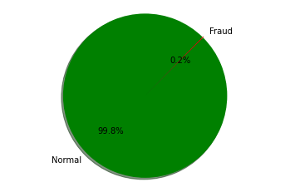
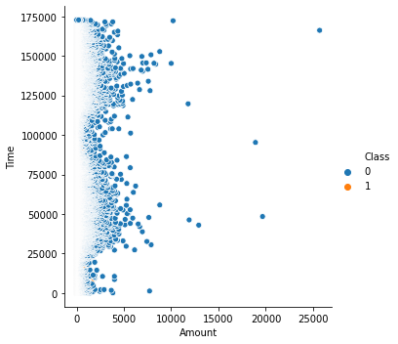
EXPLORATORY DATA ANALYSIS (E.D.A)
The exploratory data analysis of the continuous features of the data are conducted by means of Pie Plot, Scatter Plot, Box Plots and Violin Plots.
The Pie chart indicates that the data is highly unbalanced and 99.8% of the transactions are normal and only 0.2% of the transactions are Fraud.
The Scatter Plot between the “Time” and the “Amount” indicates that there is hardly any presence of Fraud transactions in data

Slide 5
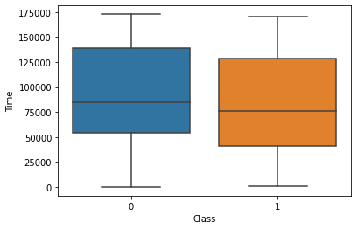
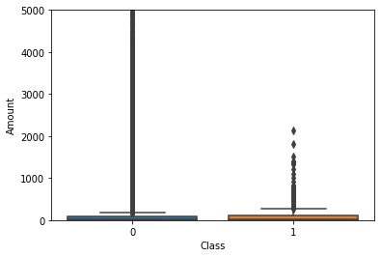
The Class “1” and Class “0” denotes the normal and Fraud transactions respectively.
The boxplot of the feature “Time” indicates that the Fraud has been taking place throughout every time period along with the normal transactions.
We can hardly notice the presence of outliers.
The median of both the Fraud and normal transaction is present between 75000 sec and 100000 sec after the first transaction.
The boxplot of the feature “Amount” indicates that the Fraud transaction is taking place below the “Amount” class of 3000 and above 3000 there is no presence of Fraud Transaction.
In Fraud transaction there is presence of Outliers.
The median is below 1000 for both cases.

Slide 6
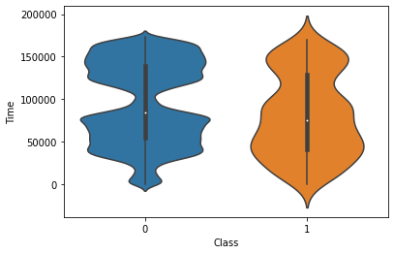
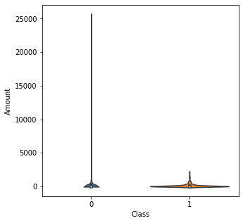
In order to keep track of the distribution we plot the violin plot.
From the above figure we can see that the almost everywhere there is a Fraud Transaction and the same goes for Normal Transaction.
But around 100000 seconds after the First transaction the distribution of the Normal transaction becomes very low and the Fraud Transaction's distribution become relatively high.
In case of Fraud transaction within 100000 seconds and 150000 seconds the distribution slightly sinks and also while approaching near 200000 seconds after the First transaction the distribution of the Fraud Transaction hugely sinks. Otherwise it remains quite even throughout.
The Fraud transaction takes place below the “Amount” class of 5000 and the distribution is really dense there for Fraud Transaction.
The Normal Transaction takes place throughout the every class of the “Amount” feature although the distribution is dense below 5000 Amount class.

Slide 7
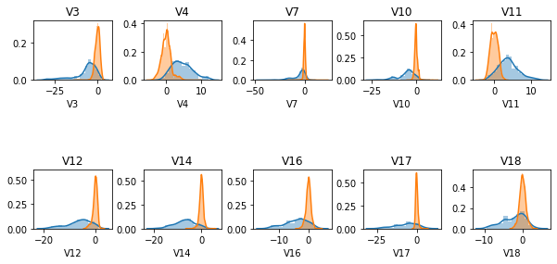
FEATURE SELECTION
Feature selection is a technique where we choose those features in our data which contribute most to the target variable as a result of which the efficiency of the model is increased.
In this data we have 30 features in total except the “Class” feature. In order to improve the efficiency of the model we have sort out the 10 prominent features which contribute the most to the target variable and drop the rest. By applying SeletKBest with k=10 from the library sklearn.feature_selection we have sort out the 10 prominent features and 20 non prominent features. The prominent features are cited below:

Slide 8
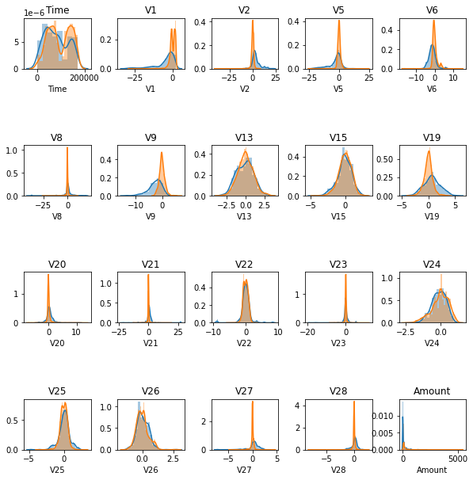
The non prominent features are cited below:

Slide 9
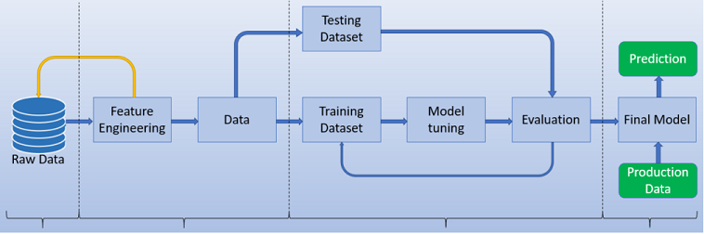
PIPELINE OF THE MACHINE LEARNING MODEL

Slide 10
MODELS USED IN THIS PROJECT
LOGISTIC REGRESSION MODEL
SVM MODEL
NAÏVE BAYES MODEL
K NEAREST NEIGHBOURS MODEL
DECISION TREE MODEL
RANDOM FOREST MODEL
XGBOOST
CONVOLUTIONAL NEURAL NETWORK MODEL

Slide 11
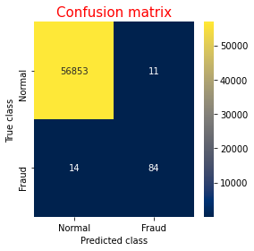

RESULTS FROM MACHINE LEARNING MODELS
After fitting all the Machine Learning models on the dataset like Logistic Regression ,SVM , KNN , Decision Tree, Random Forest & XGBoost we are getting better accuracies of the predicted output with the help of Random Forest and KNN. We are presenting the fitted models here with obtained accuracy and confusion matrix.
Random Forest model
KNN model

Slide 12
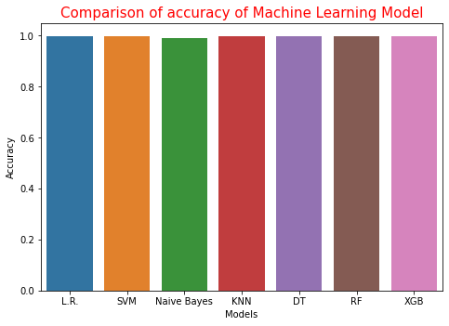
SUMMARY OF ACCURACY OF MACHINE LEARNING MODEL
>> >> From the table and the diagram it is evident that every accuracy of
the machine learning models are very high among which KNN and
Random Forest have the highest accuracy.
MODEL | ACCURACY | PRECISION SCORE | RECALL SCORE | F SCORE
LOGISTIC REGRESSION | 0.9992977774656788 | 0.881578947368421 | 0.6836734693877551 | 0.7701149425287356
SVM | 0.9994557775359011 | 0.8526315789473684 | 0.826530612244898 | 0.839378238341969
NAÏVE BAYES | 0.9907482181103192 | 0.1454545454545454 | 0.8979591836734694 | 0.2503556187766714
KNN | 0.9995962220427653 | 0.9032258064516129 | 0.8571428571428571 | 0.8795811518324608
DECISION TREE | 0.9994557775359011 | 0.8316831683168316 | 0.8571428571428571 | 0.8442211055276382
RANDOM FOREST | 0.9996839998595555 | 0.9761904761904762 | 0.8367346938775511 | 0.9010989010989012
XGBOOST | 0.9995611109160493 | 0.8842105263157894 | 0.8571428571428571 | 0.8704663212435233

Slide 13
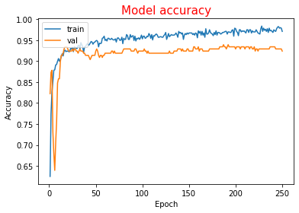
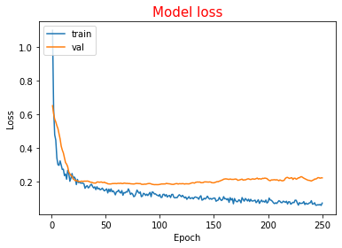
RESULTS FROM CNN
Since the dataset is highly unbalanced we took a sample of the Normal transaction with sample size equal to the Fraud transaction after which we standardize the data to finally making it ready for training.
After that we pass our dataset to our neural network model and taking a learning rate of 0.0001 and running for 250 epochs we train the model and finally obtain the loss and the accuracy curve.
The model start with the training accuracy of 0.6252 and validation accuracy of 0.8223. At the end of the 250th epoch we got a training accuracy and training loss value of 0.9708 and 0.0707 respectively and validation accuracy and loss value of 0.9239 and 0.2212 respectively which shows a slight overfitting of the model although it can be ignored. The accuracy curve and loss curve is given below:

Slide 14
CONCLUSION AND FUTURE WORK
After completing all the classification algorithms it is concluded that under various conditions Random Forest performed the best among them. After feature selection and hyper-parameter tuning the performance of the models are increased by 15-20%. Sampling methods provided much better result compared to the raw data . Comparing all the models under every conditions Random Forest performed the best in case of Accuracy, Precision score , Recall Score as well as F1 Score.
For future work the efficiency of the models can be improved if the dataset is larger and balanced so that the sampling method is not needed . If the original values of the dataset are known then we can know how the data is correlated and which features are really important and train accordingly . In future different methods can be used to improve the results and more hyper-parameter tuning can be done.

Slide 15
THANK YOU

